Slide 1

Investigating contributions of distinct features of images to object processing in the human brain
Oval Bongos
Team: PenTango
Alfaxad Eyembe, Andréanne Proulx, Hanxiao Lu, Pablo Meré, Sydney van Engelen
Notes:
Sydney

Slide 2

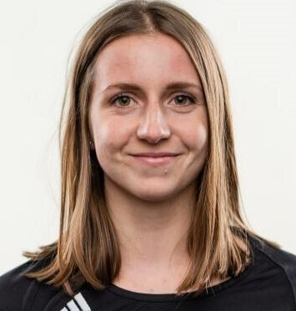





PenTango team
Andréanne Proulx
MSc Student
Cognitive Neuroscience
University of Montreal
Sydney van Engelen
MASc Student
Biomedical Engineering
Queen’s University
Vy Vo, PhD
Project mentor
AI/ML Research Scientist
Intel Labs
Hanxiao Lu
BA in Neuroscience, Smith College 19’
Affiliated with Psychology Dept. at Yale and Computational Psychiatry Unit at Mt.Sinai
Pablo Meré-Hidalgo
BSc in Mathematics University of Guanajuato & CIMAT A.C.
Alfaxad Eyembe
Ashinaga Candidate (Tanzania)
Undergraduate Bsc in Computer Science (Japan).
Nicholas Blauch
Project TA
Ph.D. candidate in Neural Computation
Carnegie Mellon
Notes:
Sydney

Slide 3
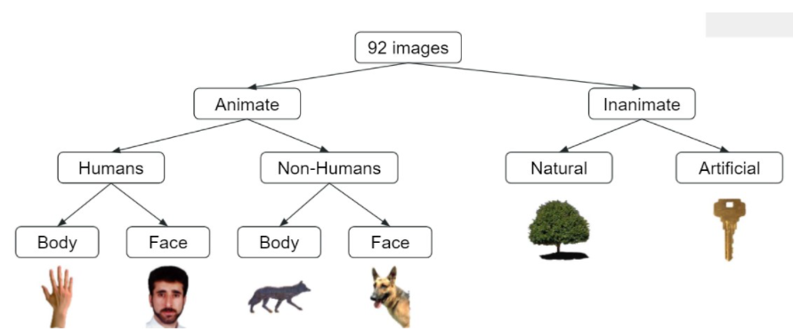
Introduction
Prior literature has focused on investigating supervised machine learning classifiers to neural responses (Cichy et al., 2014)
These classifiers demonstrated that neurons in the inferior temporal (IT) cortex distinguish objects through a system of hierarchical categories (Fig. 1)
However, it remains elusive whether the spatio-temporal patterns of neural activities are a reflection of these hierarchical categories or if they can be accounted for by other attributes of these images
Fig.1. 92 Images used by Cichy and Colleagues (2014)
Notes:
Sydney:
In daily life, human brain perceive and categorize objects in a quick and seemingly effortless way. To understand how brain actually process such object categorization process, prior literature has mainly focused on this by applying supervised machine learning classifiers to neural responses recorded from tasks in which humans (and monkeys) were asked to view images of isolated objects. These classifiers have demonstrated that neurons in the inferior temporal (IT) cortex distinguish objects through a system of hierarchical categories that is consistent with the predefined structure. However, it remains elusive whether the patterns of neural activities are a reflection of these hierarchical categories shown in figure 1 or if they can be accounted for by other attributes of these images such as image features, sentiment, and familiarity.

Slide 4
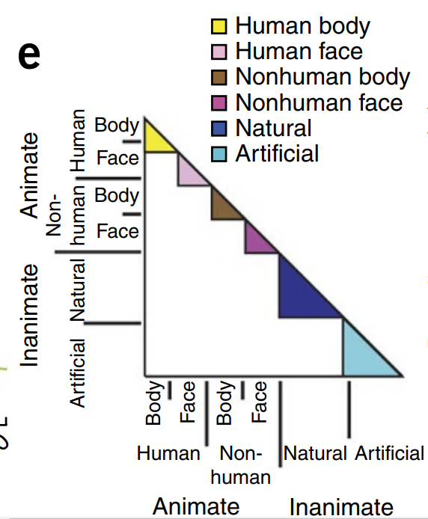
Purpose
To investigate whether other attributes of the 92 images may have confounded the prior results by computing representational dissimilarity matrices (RDMs) of other features of these images, such as…
Deep neural network visual attributes
Sentiment
Familiarity
and use them as predictors of the neural RDMs in IT regions
Cichy et al., 2014
Notes:
Sydney
Thus we are interested in the question: what other features of images actually contribute to the neural representation of the categorization in human brain? We will do this by investigating whether other attributes may have confounded the prior results by computing representational dissimiliarity matrix of other features of these images, such as lower/high-level deep neural network attributes, sentiment and familiarity and use them as predictors of the neural RDMs computed in IT regions (fMRI).

Slide 5
Our Approach
2
4
1
3
Data Visualization
Results
Data Collection
Representational Dissimilarity Matrices (RDMs)
Activation maps using a pre-trained convolutional neural network, Alexnet
Data Analysis
Cichy dataset
Voluntary participants (n = 33)
Online survey
Evaluating the sentiment and familiarity of the 92 images
Correlation
Regression
Variance partitioning
Notes:
Andreanne
We used the dataset from Cichy (2014) to compute the RDM for neural responses in IT and EVC regions and used the pretrained convolutional network model (AlexNet model) to extract the weights of 8 layers and compute RDM for each layer as well.
Additional behavioral data for other features of images were collected from voluntary participants (n = 33) with a survey deployed online assessing sentiment and familiarity of the 92 images in the original study.

Slide 6
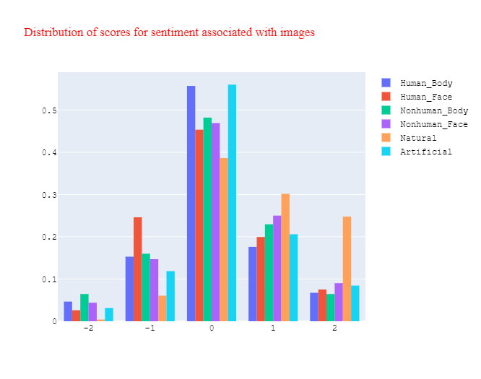
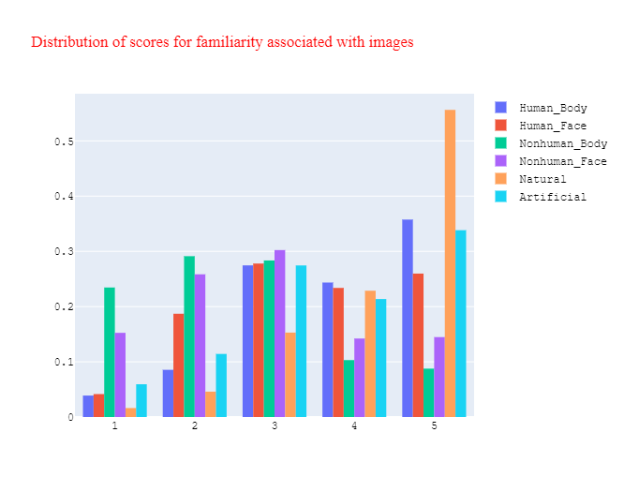

Slide 7
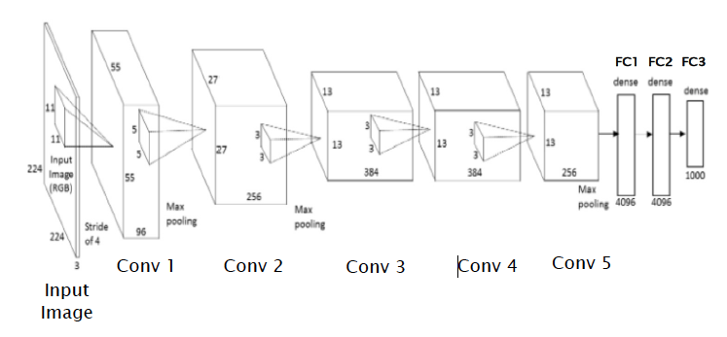
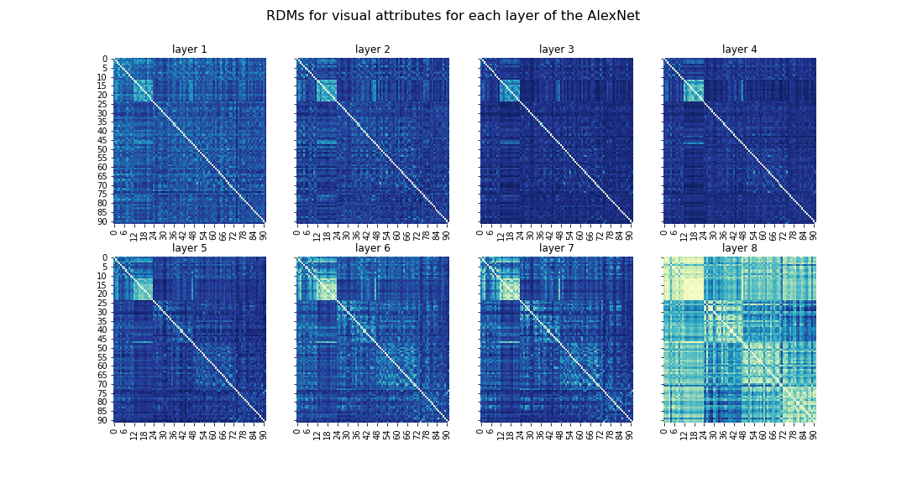
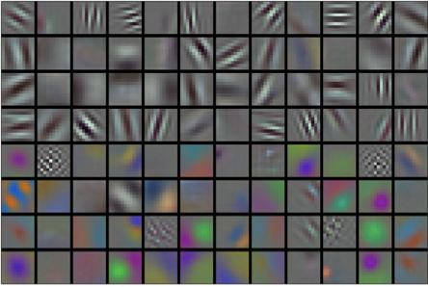
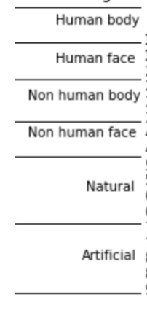
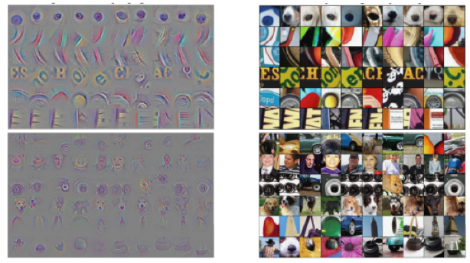
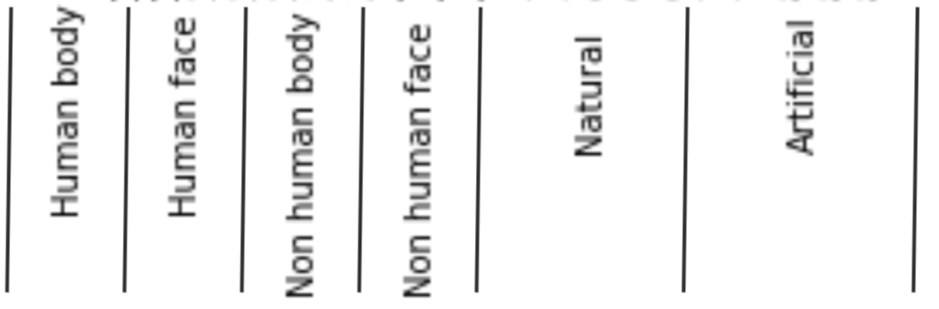
Results - Visual attributes
AlexNet architecture
Krizhevsky & al, 2012
Low level attributes
High level attributes
Layer 1
Layer 8
Notes:
Here we present the RDMs computed for each feature of interest:
This slide shows the RDMs for each convolutional layers computed from the output of AlexNet
The first layer represent lower level attributes such as edges, color and orientation, whereas later layers represent more complex features.

Slide 8
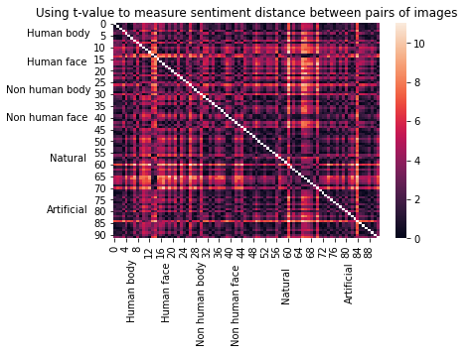
Results - Sentiment
Category | Mean | Standard Deviation
Human Body | 0.06 | 0.88
Human Face | 0.05 | 0.92
Non-human Body | 0.07 | 0.95
Non-human Face | 0.20 | 0.95
Natural | 0.73 | 0.92
Artificial | 0.19 | 0.87
How do you feel immediately about this image?
Strongly Negative (-2)
Somewhat Negative (-1)
Neutral (0)
Somewhat Positive (+1)
Strongly Positive (+2)
Notes:
After viewing the image for 500ms,people were asked: how do you feel immediately about this image? People rate the sentiment from strongly negative to strongly positive on a 5-point likert scale.
This is the RDM computed from the data collected for sentiment. As we observe no clear delineation of this heatmap, sentiment response does not give good insight in distinguishing categories of these 92 images.

Slide 9
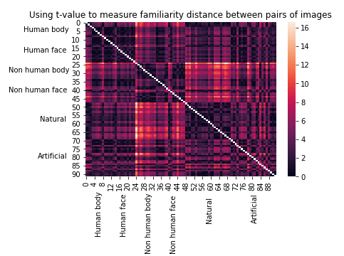
Results - Familiarity
Category | Mean | Standard Deviation
Human Body | 3.80 | 1.13
Human Face | 3.48 | 1.18
Non-human Body | 2.52 | 1.21
Non-human Face | 2.87 | 1.26
Natural | 4.26 | 0.99
Artificial | 3.66 | 1.22
How likely it is for you to see the content of this image in real life?
Rare (1)
Unlikely (2)
Possible (3)
Likely (4)
Certain (5)
Notes:
People were also asked: how likely it is for you to see the content of this image in real life? People also rate the likelihood on a 5-point likert scale from rarely to certainly.
In this heatmap, we find such a delineation between categories of images, suggesting that familiarity might be an interesting dimension of these images.

Slide 10
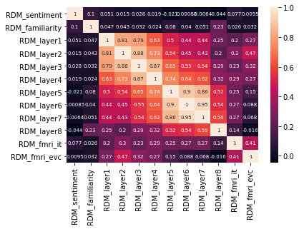
Results - Correlation
Notes:
Alfaxad
Then we computed the correlation matrix for all the RDMs of interest, including the RDM of neural representation in IT, EVC regions.
Sentiment and familiarity RDMs are not in strong correlation with neural representation RDMs
(click) However low to mid level RDMs from CNN layers do correlate well with the fMRI RDMs (click) Low level layer 2 correlates strongly for both IT and EVC
(click), In addition, we also observe a medium-size correlation between RDM_layer 8 and familiarity.

Slide 11
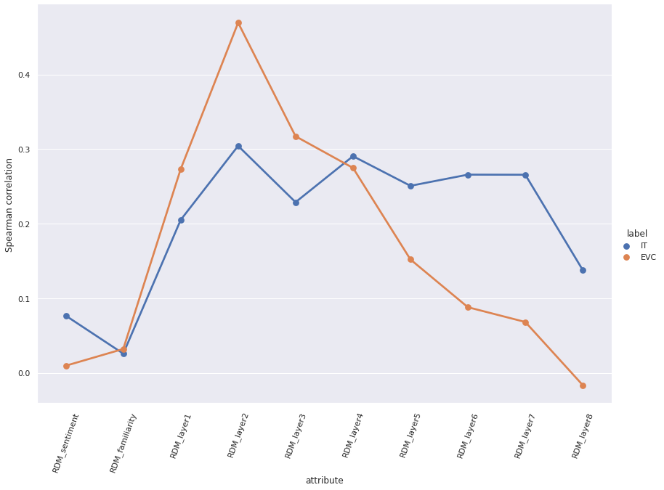
Results - Correlation
Notes:
Alfa
This is different figure that highlights the correlation of feature RDMs with neural representation in regions of interest.

Slide 12
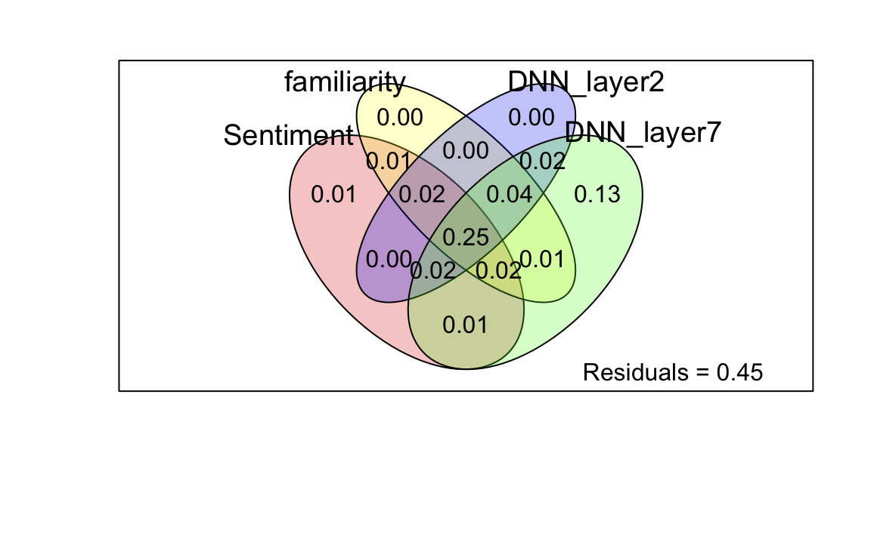
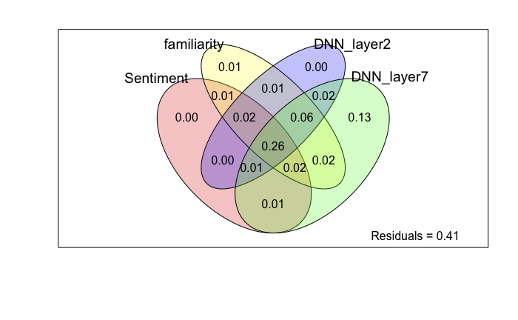
Results - Multiple Linear Regression
Variance partitioning analysis
Adjusted R squared: 0.53
Adjusted R square: 0.51
EVC
IT
Notes:
Hanxiao
We selected a subset of features to compute multiple linear regression to predict the fMRI RDMs in each brain region and found that our features can explain up to more than 50% of the variance. We also ran a variance partitioning analysis to show the unique contribution of each feature and the variance they commonly shared to explain.

Slide 13
Discussion and Future Direction
Neural representations in IT region are more strongly correlated with high-level abstract representation of the images (layer 7), but not as abstract as the hierarchical structure of categories (layer 8) indicated in Cichy 2014.,
Behavioral features of images, such as familiarity, could be a potential contributor to image processing in human brain.
Future research should consider:
Using stimuli controlling for behavioral and visual features of images
Adding softmax function to compute a different DNN layer 8
Testing nonparametric tests on regression (we violate the normality test)
Notes:
Our results indicate that, different from what Cichy 2014 papers claims,

Slide 14
Conclusions & Future Directions
Layer 7 explains most amount of variance in the fMRI RDMs
Suggests low level features and high lever are potential confounders of previous results in visual object recognition
Would be interesting to look at the progression : early layers explain visual cortex best
Adding softmax function to the output
Testing non-linear model (we violate the normality test)

Slide 15

Thanks to...
Our Project Mentor: Vy Vo,
Our Project TA: Nicholas Blauch,
Our Pod Leader: Akanksha Gupta,
Our Pod: Oval Bongos
And NMA for all of the feedback and support!
PenTangos!

Slide 16
References
Cichy, R., Khosla, A., Pantazis, D. et al. Comparison of deep neural networks to spatio-temporal cortical dynamics of human visual object recognition reveals hierarchical correspondence. Sci Rep 6, 27755 (2016). https://doi.org/10.1038/srep27755
Groen II, Greene MR, Baldassano C, Fei-Fei L, Beck DM, Baker CI. Distinct contributions of functional and deep neural network features to representational similarity of scenes in human brain and behavior. Elife. 2018 Mar 7;7:e32962. doi: 10.7554/eLife.32962. PMID: 29513219; PMCID: PMC5860866.
Representational similarity analysis – connecting the branches of systems neuroscience. Kriegeskorte et al. Front. Syst. Neurosci., 2008
Resolving human object recognition in space and time. Cichy et al. Nature Neuroscience 2014
Krizhevsky, A., Sutskever, I., & Hinton, G. E. (2012). Imagenet classification with deep convolutional neural networks. Advances in neural information processing systems (pp. 1097–1105).

